Slide 1
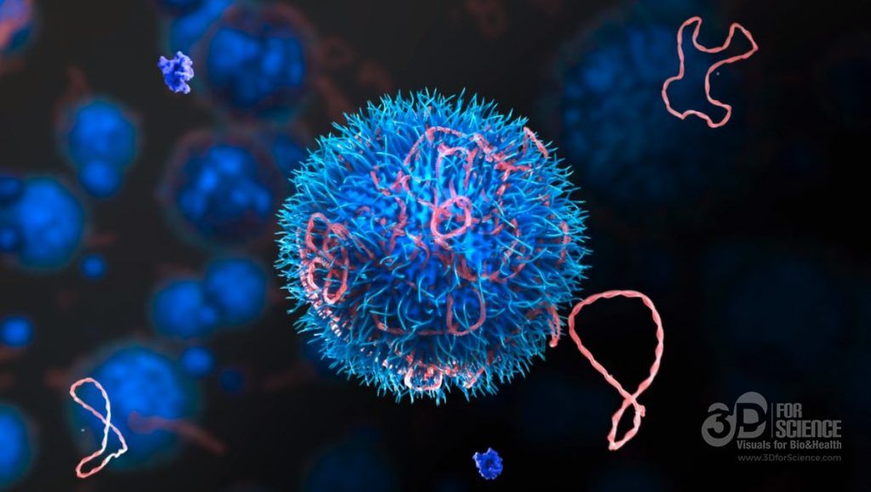

Mechanisms of Action(MoA) Prediction
Phase I
Xinbo Xia
Haoyu Guo
Rocha Zhou
https://github.com/guohaoyu110/EE542_final
Notes:
Slides can vary as per your presentation, but header and footer should be consistent

Slide 2
Project Schedule
By Nov 16 : Finish data processing (prepare data for training)
Nov 16 - Nov 23 : Deploy machine learning algorithm
Nov 23 - Nov 30: Try more deep learning algorithms and do transfer learning
Nov 30 - Dec 9: Model assembling and integration, submit the task and write report

Slide 3
Before we dive into the data pre-processing, we need to understand
the related background and the details of our data set first.

Slide 4
Background of MoA
In the past, scientists derived drugs from natural products or were inspired by traditional remedies. Very common drugs, such as paracetamol, known in the US as acetaminophen, were put into clinical use decades before the biological mechanisms driving their pharmacological activities were understood.
Today, with the advent of more powerful technologies, drug discovery has changed from the serendipitous approaches of the past to a more targeted model based on an understanding of the underlying biological mechanism of a disease. In the new framework, scientists seek to identify a protein target associated with a disease and develop a molecule that can modulate that protein target. As a shorthand to describe the biological activity of a given molecule, scientists assign a label referred to as mechanism-of-action or MoA for short.

Slide 5
How to determine the MoA of new drug
One approach is to treat sample of human cells with the drug and then analyze the cellular responses with algorithms that search for similarity to known patterns in large genomic databases, such as libraries of gene expression or cell viability patterns of drugs with known MoAs.
In this competition, we will have access to a unique dataset that combines gene expression and cell viability data. The data is based on a new technology that measures simultaneously human cell’s responses to drugs in a pool of 100 different cell types, in addition, we have access to MoA annotations for more than 5,000 drugs in this dataset.

Slide 6
Data Set
Test_features.csv: Features for the test data.
Train_drug.csv: Drug id corresponding to every sig_id(sample id) for training set only.
Train_features.csv: Features for the training set. (Details in later slides)
Train_targets_nonscored.csv: Additional(optional) binary MoA responses for the training data. (not predicted nor scored, but may also be useful )
Train_targets_scored.csv: The binary MoA targets that are scored.
Let’s take a deeper look at these data sets.

Slide 7
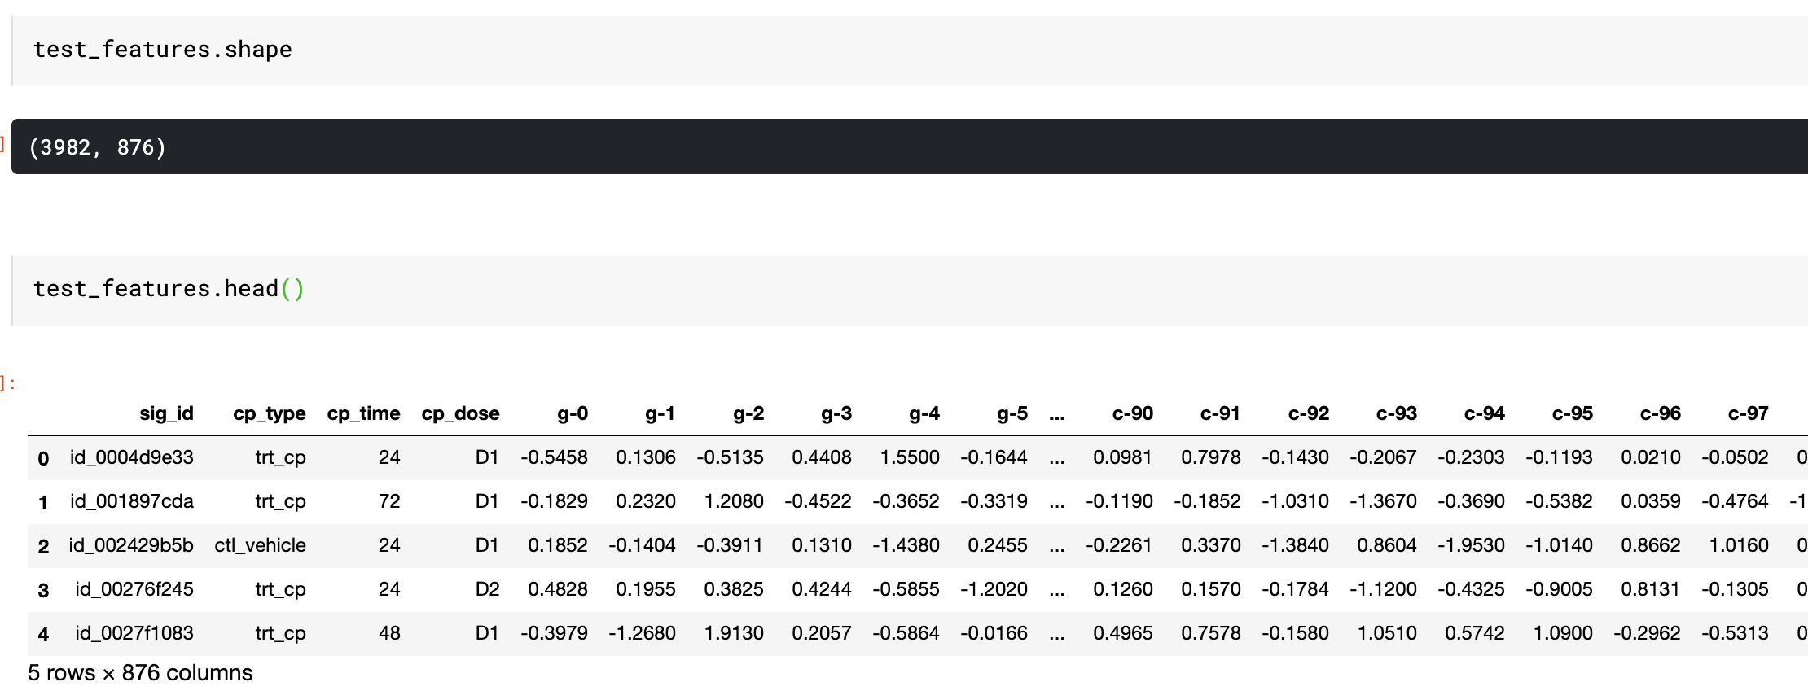
Test_features.csv
3982 unique entries
Sig_id: sample id g- : gene expression(0 - 771) c- : cell viability(0 - 99)
3 cp features:
cp_type (trt_cp and ctl_vehicle)
cp_time: treatment time
cp_dose: dose(D1 and D2)

Slide 8
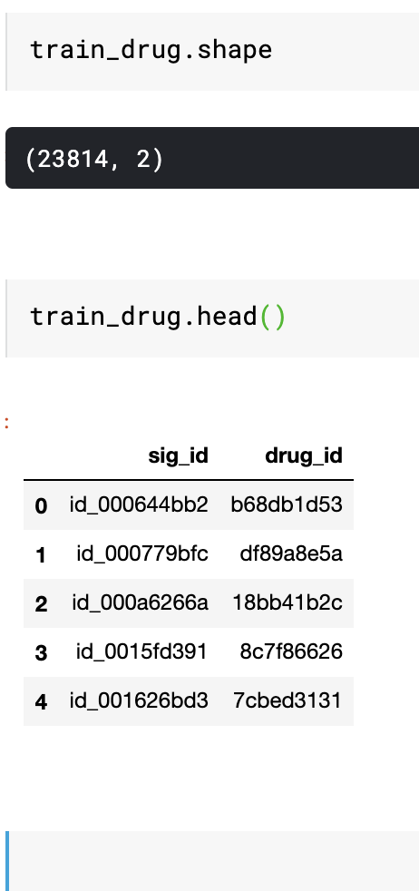
Train_drug.csv
Total of 23814 entries (for training set only)
Each sig_id represents one type of drug

Slide 9
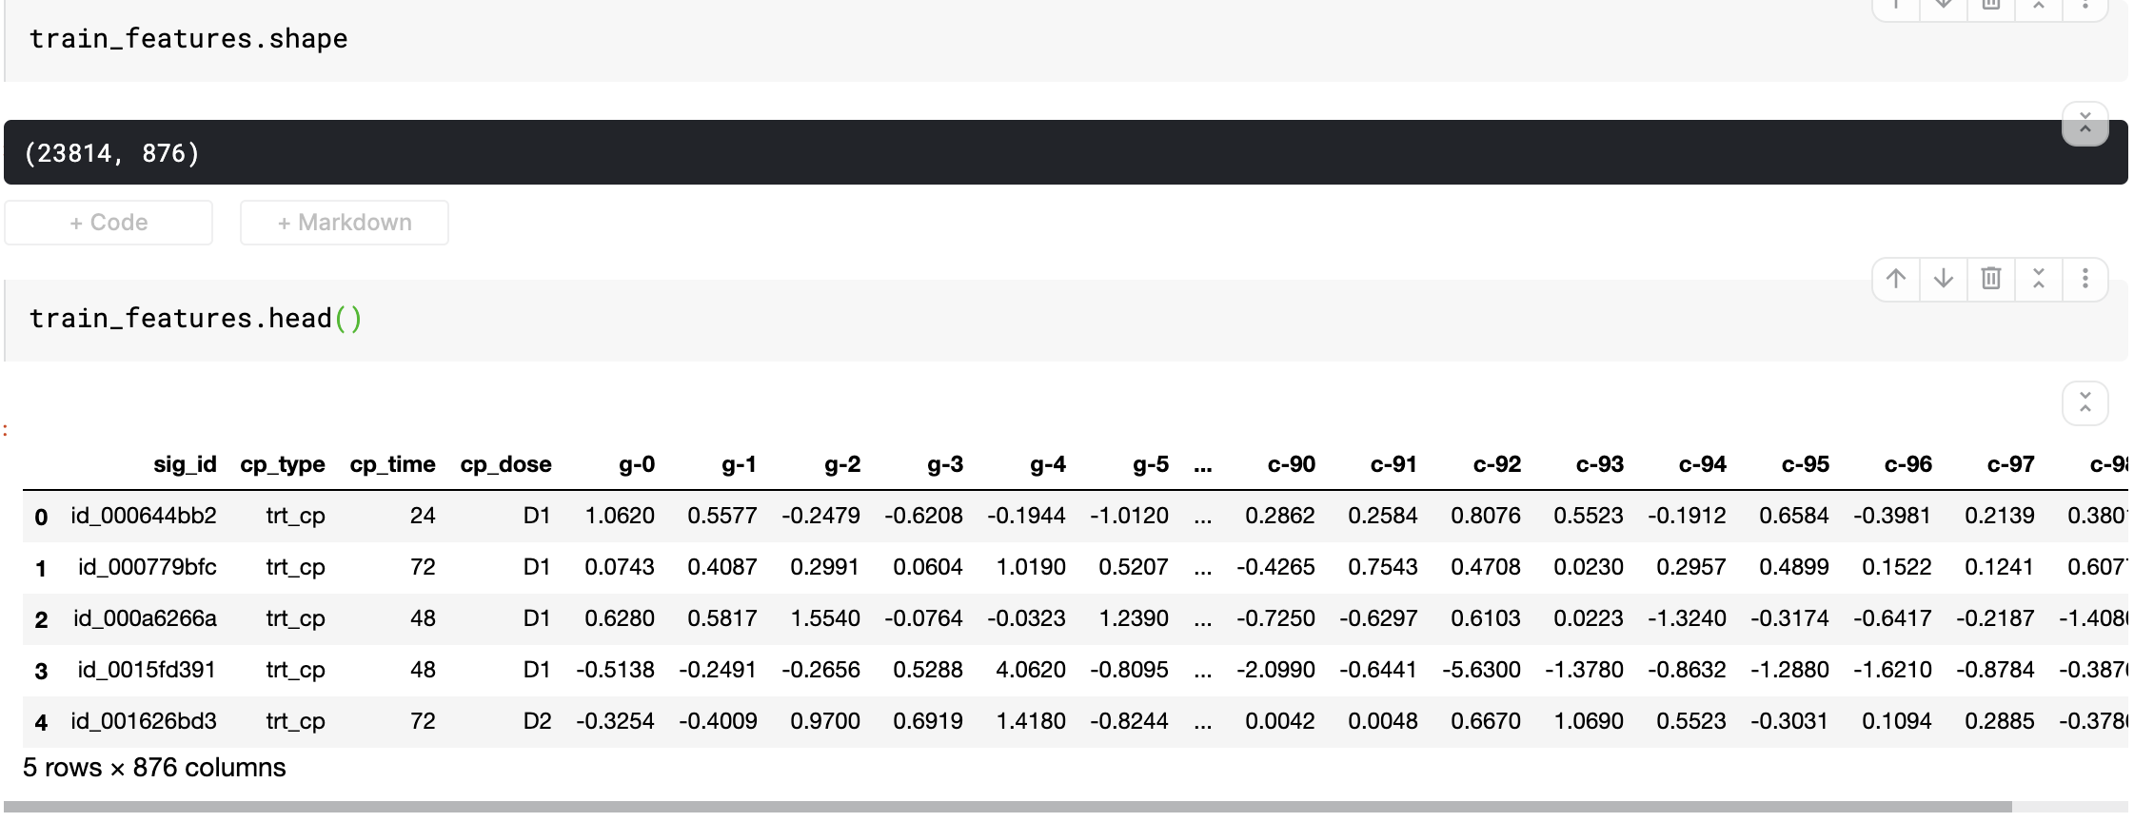
Train_features.csv
Same layout as test_features.csv, except that we have 23814 entries for training

Slide 10
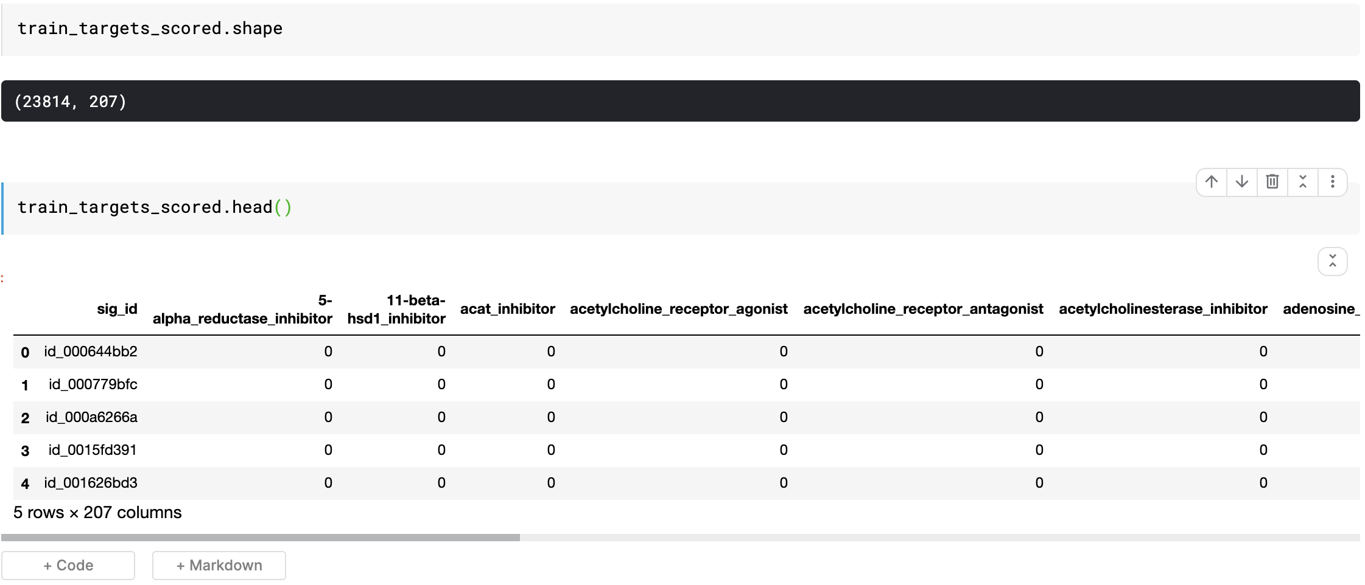
Train_targets_scored
23814 entries and 206 classes (columns)

Slide 11
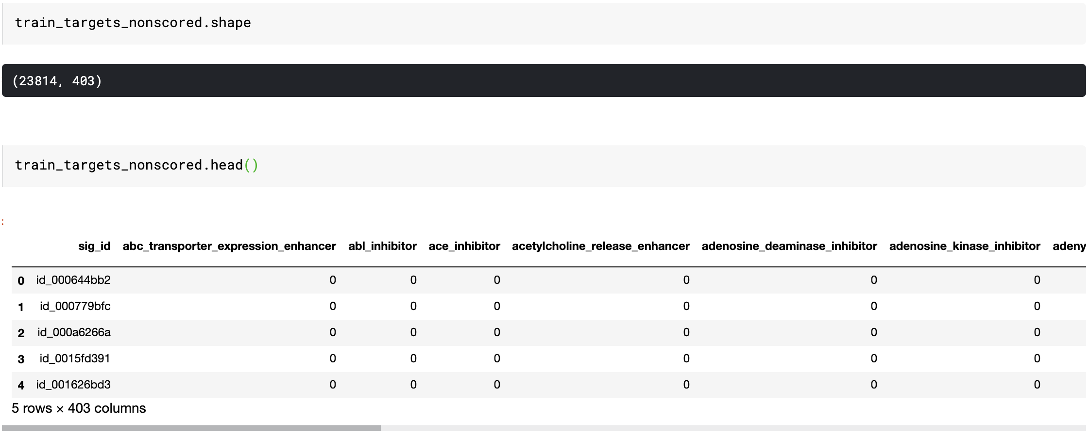
Train_targets_nonscored
For each entry, here’s over 400 more classes

Slide 12
Further Statistical Analysis of given data sets

Slide 13
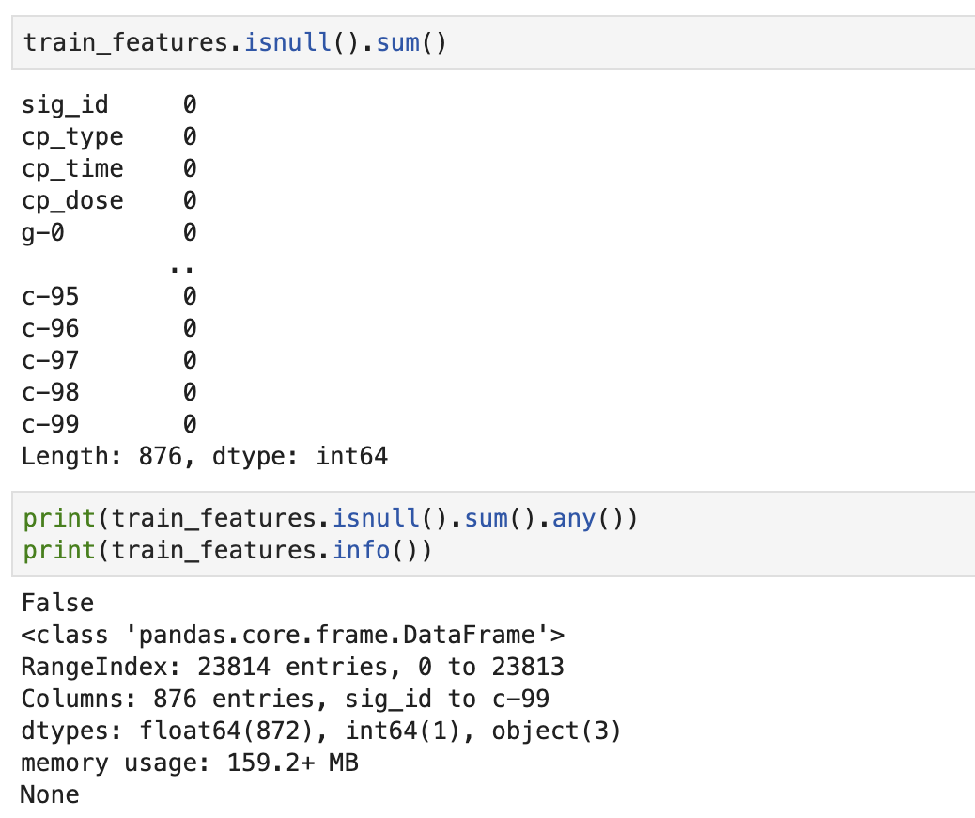
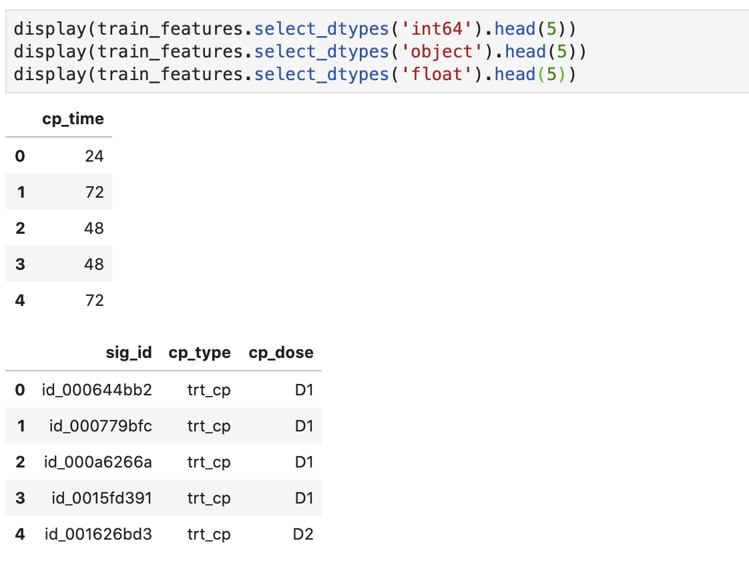
Check null or not
There are no missing values in the train_features dataset and test_features dataset. There are 872 float types, 1 integer and 3 objects.

Slide 14
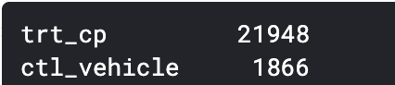
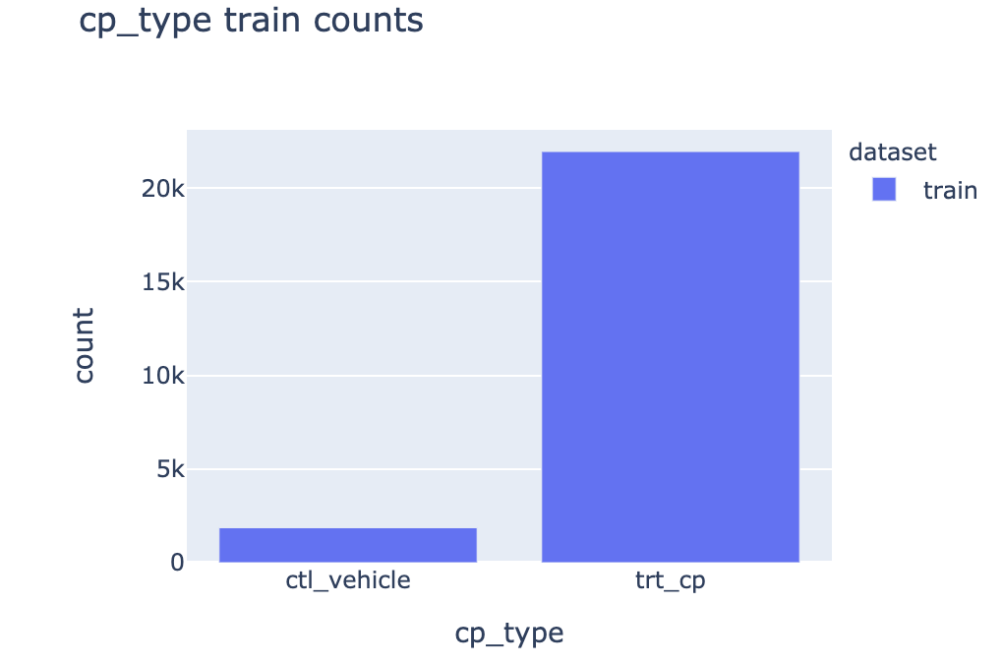
Features Analysis

Slide 15
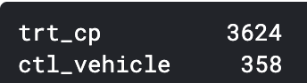
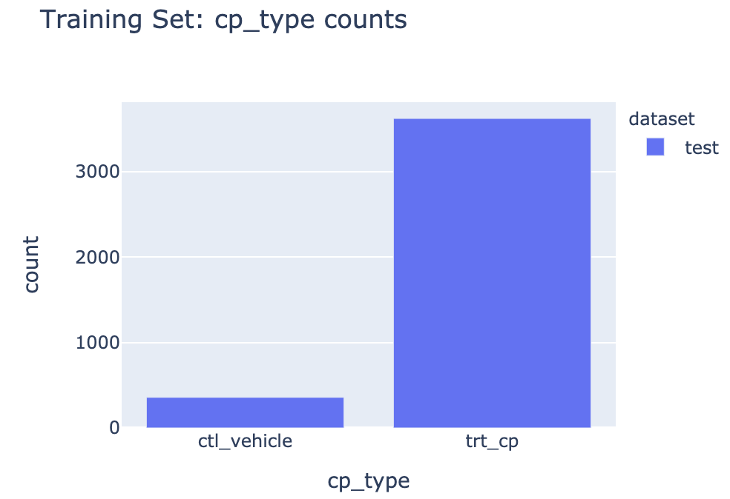
Features Analysis

Slide 16
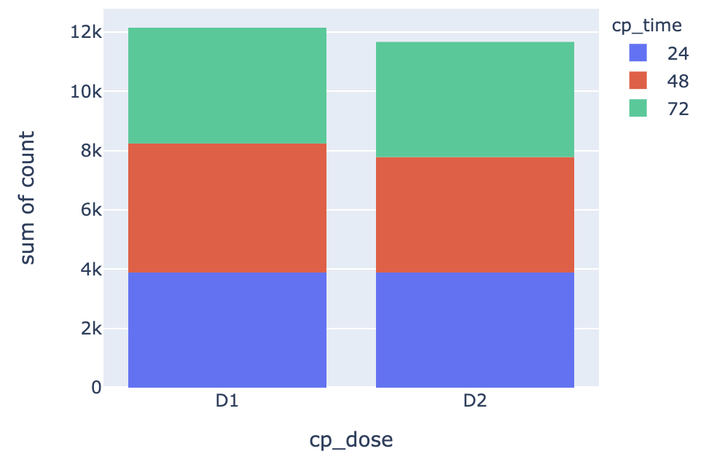
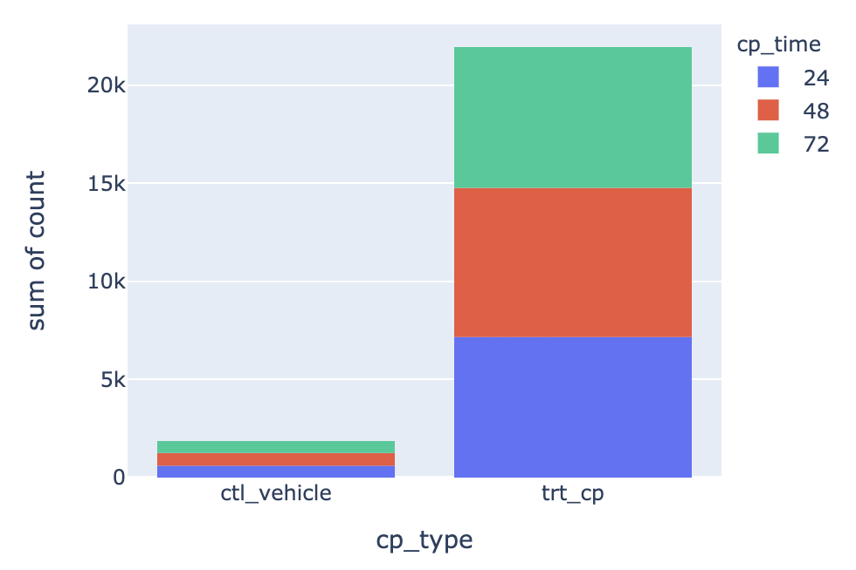
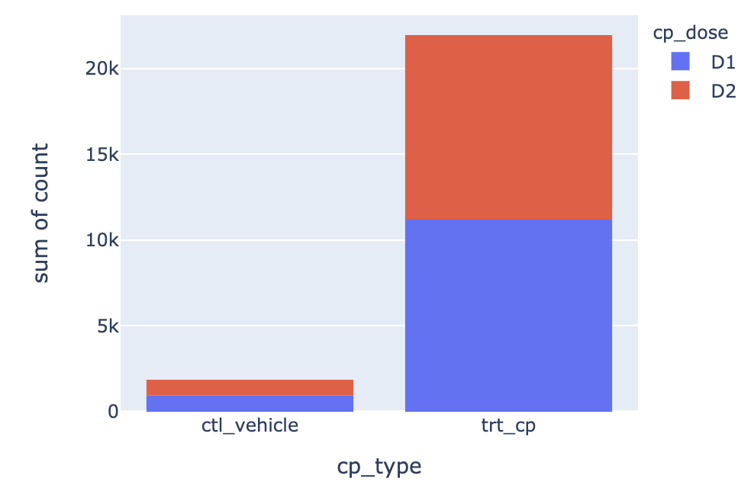
Features Analysis

Slide 17
Features Analysis
For 3 cp features, the distribution are consistent in that control treatments are similarly rare across doses and duration.
Distribution of D1, 48hours and trt_cp is slightly higher than the others.
Next, let’s look at gene expression features and cell viability features

Slide 18
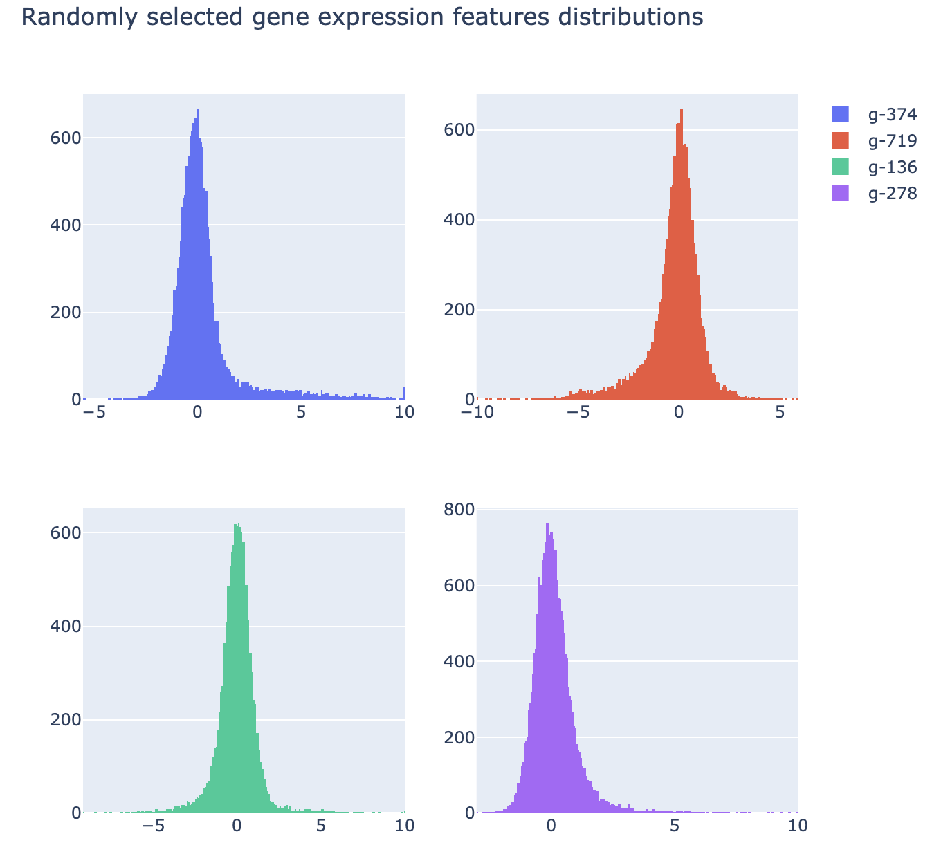
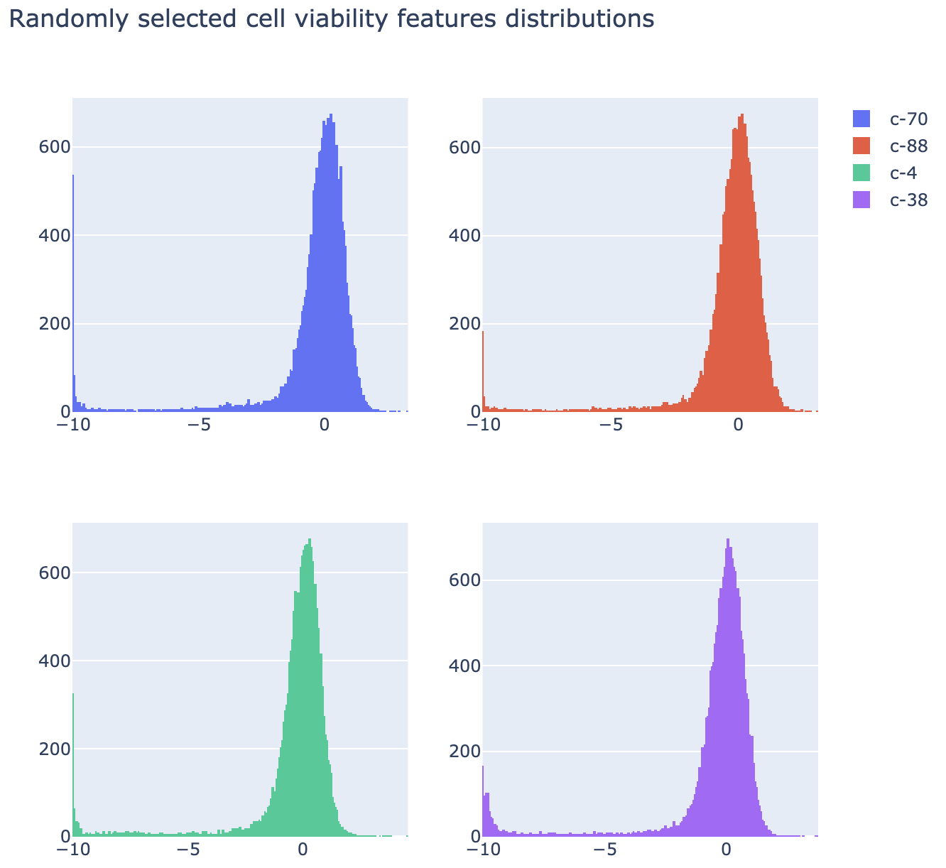
Features Analysis

Slide 19
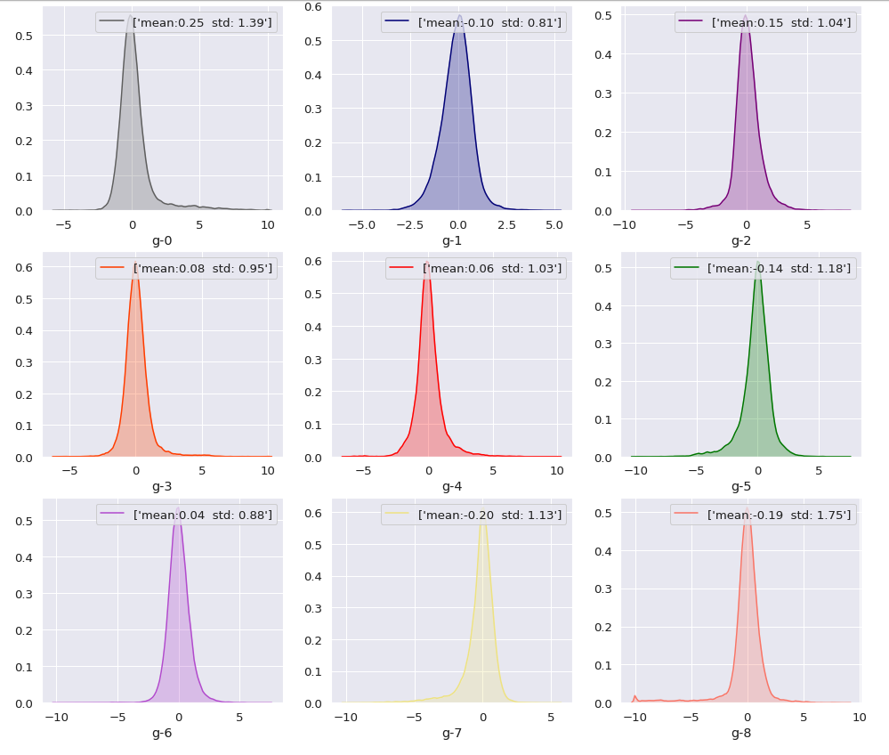
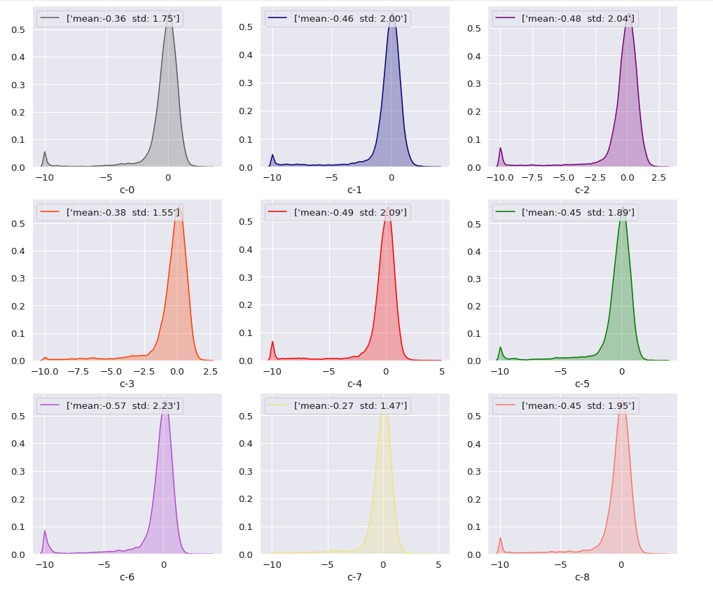
Visualize features
Notes:
from this result, we can see data are somehow normalized and also clipped at [-10,10].

Slide 20
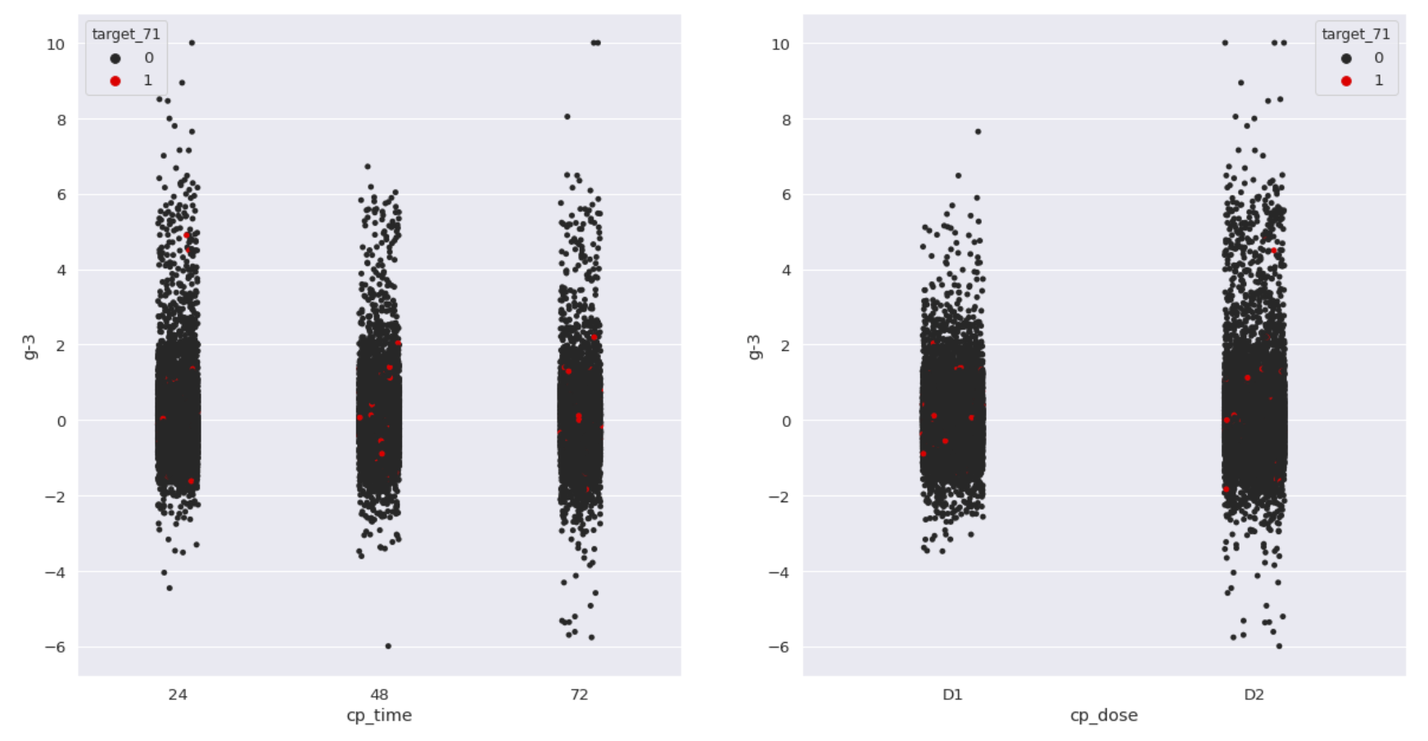
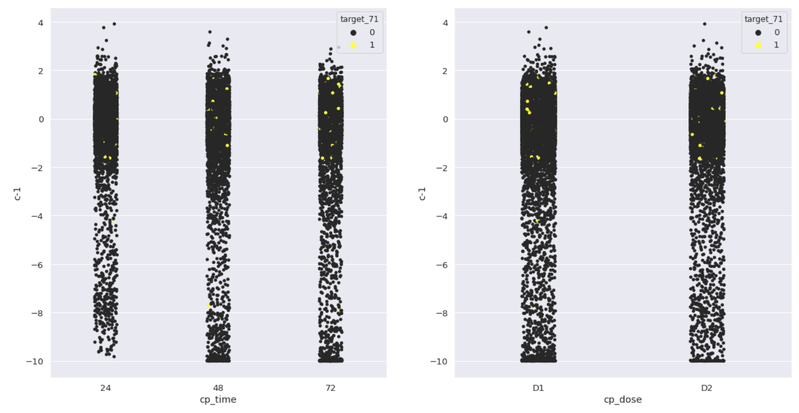
Explore relationships
We can use stripplot to show the relationship of a feature and a target with respect to dosage and time. Since, this is a multilabel problem, we only show one label here, which is target 71. This target is contributing the most to the loss. For the feature, we chose two random g and c features. We can only do this with other features and labels to get more insight. And then use the insight here to apply it in our preprocessing step.
Notes:
Next, we can use stripplot to show the relationship of a feature and a target with respect to dosage and time. Since, this is a multilabel probelm, we only show one label here, which is target 71. We will see later this target is contributing the most to the loss. For the feature, we chose two random g and c features. We can do this with other features and labels to get more insight.

Slide 21
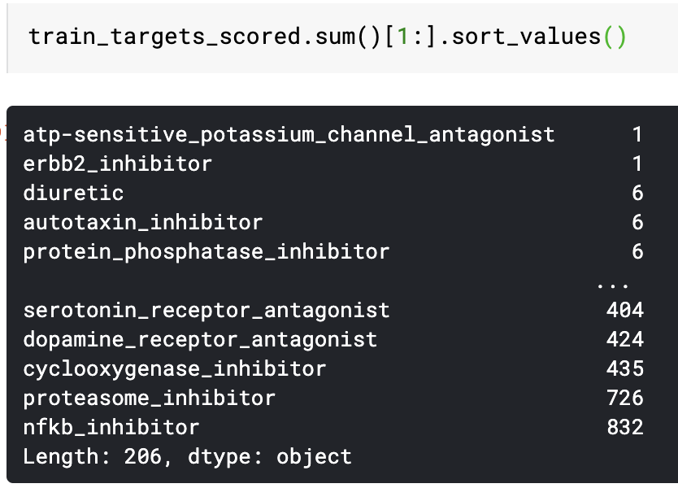
Train_target_scored analysis
Left graph shows total number of times each class appears among over 23000+ entries.
Most frequently appeared class has value of 832(3.4% with respect to total entries)
Most least frequently appeared class has value of 1.
Conclusion: Distribution of each class is quite sparse and unbalanced.

Slide 22
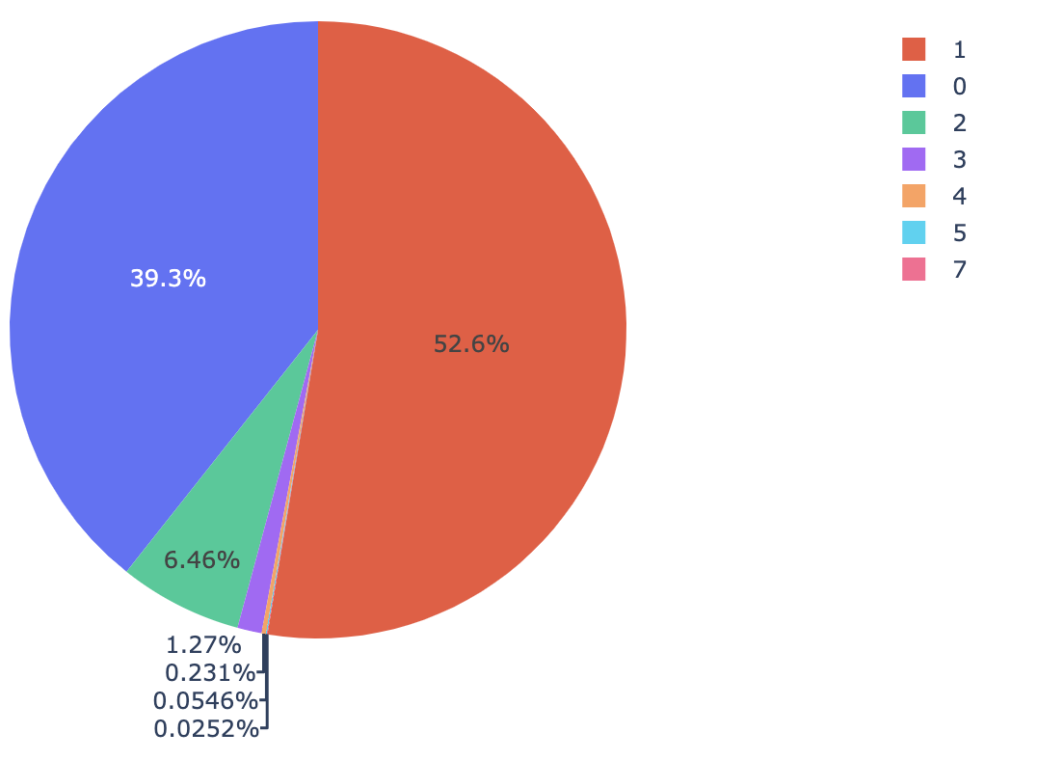
Train_target_scored analysis
Number of classes that each sample has
Left graph shows that 52.6% of samples only have one target class.
39.3% of samples have no target class at all.
6.46% of samples have 2 target classes.
Conclusion: The hit rate of target class is overall low. Discard some of the classes might be considered for later modeling.

Slide 23
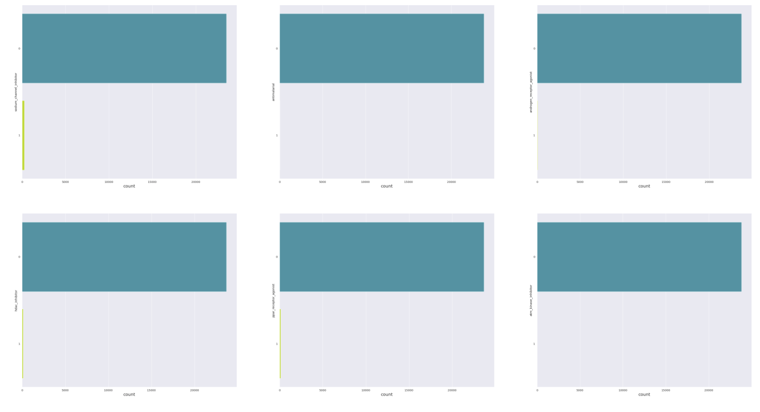
Scored Targets
Notes:
Below are some scored targets which are used to train the main model. As we can see, the targets are very imbalanced and there are only a few positive examples in some labels.

Slide 24
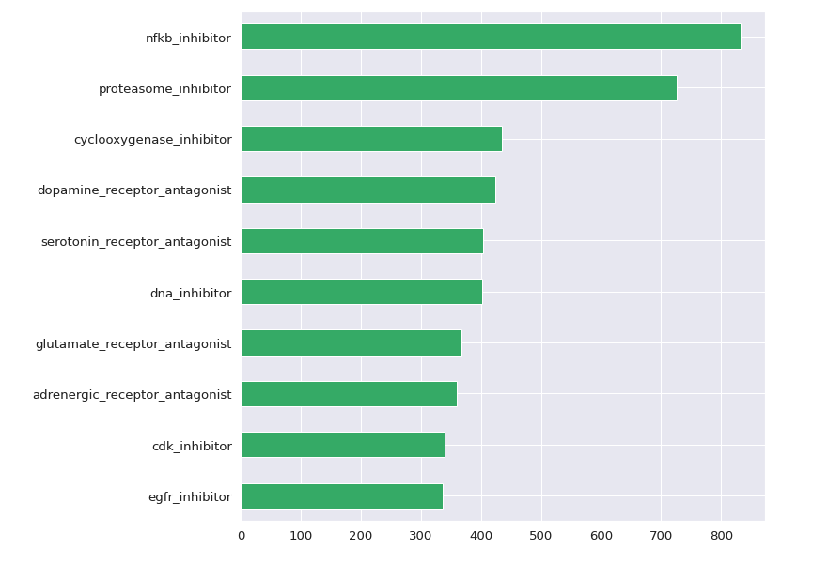
10 largest number of labels in the scored targets

Slide 25
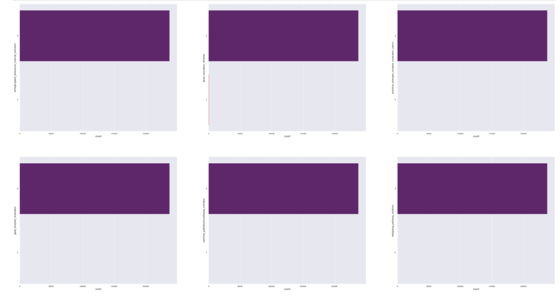
Unscored targets
Notes:
This one is also very imbalanced and very few are positive integers.

Slide 26
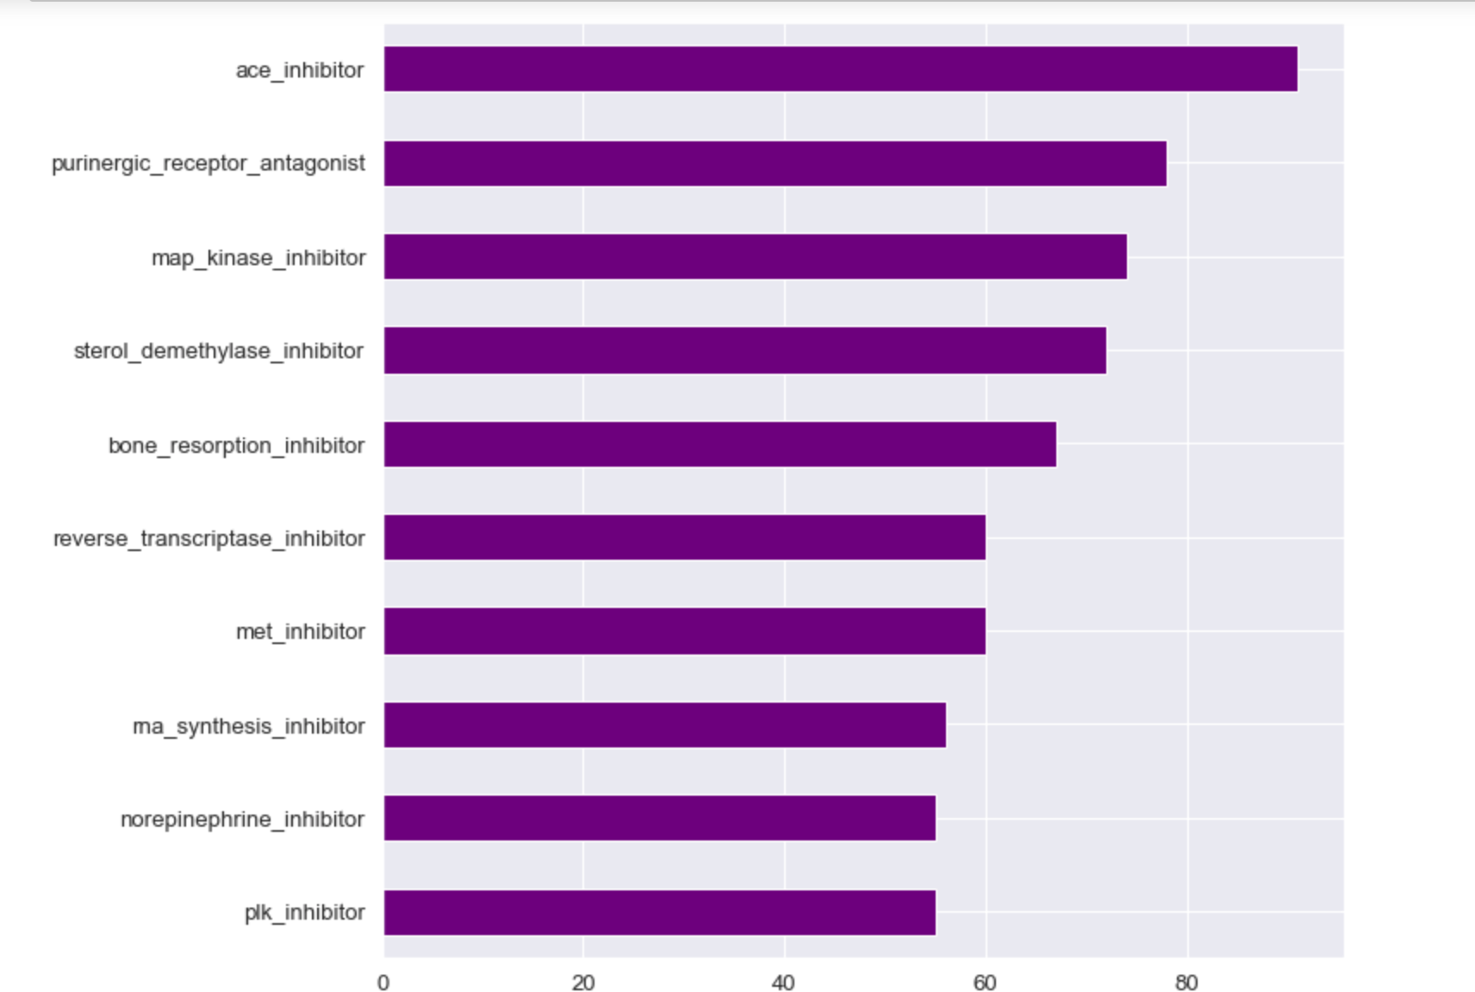
10 largest number of labels in non-scored targets
Notes:
As we can see, there are fewer positive examples in non-scored dataset

Slide 27
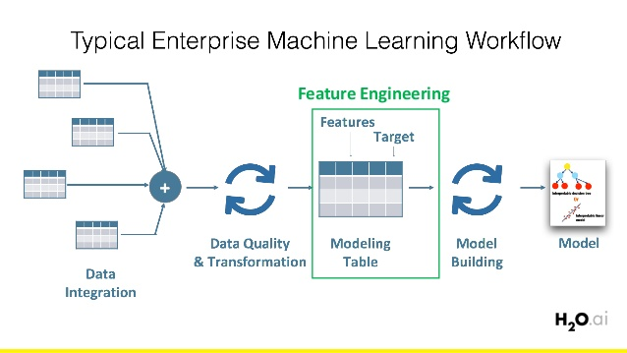
Feature engineering

Slide 28
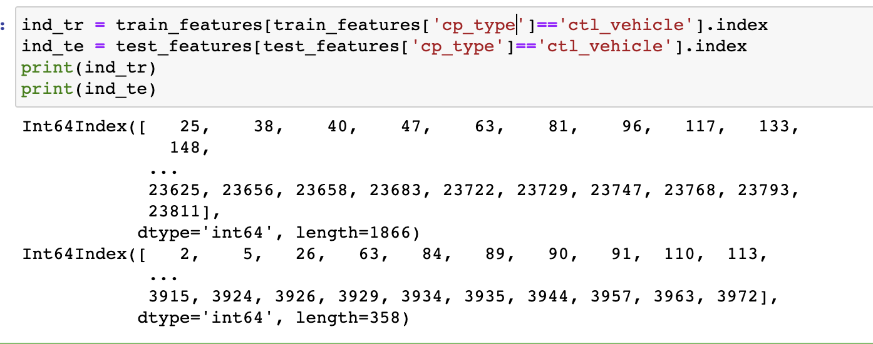
Preprocessing and feature engineering
The control group is defined as the group in an experiment or study that does not have the desired effect or MoAs here; which means the target labels are zero for them. I will drop the data for this group, and we will later set all predictions of this group to zero.
We will keep track of the control group (ctl_vehicle) indexes. I dropped cp_type column and mapped the values of time and dose features. I performed some feature engineering based on the insights I got from the kaggle notebook. I also add methods of Rankgauss and PCA for this.

Slide 29
RankGauss
How RankGauss work?
RankGauss is a popular method for feature extraction in kaggle competitions, akin to standardization. This method comes from Michael Jahrer, who is a kaggle grandmaster.
I use RankGauss to normalize. It’s based on rank transformation. First step is to assign a linspace to the sorted features from 0...1, then apply the inverse of error function to shape them like gaussians, then I subtract the mean. And this works usually much better than standard mean/std scaler or min/max.
Notes:
http://fastml.com/preparing-continuous-features-for-neural-networks-with-rankgauss/
First, let me explain what is the rankgauss method

Slide 30
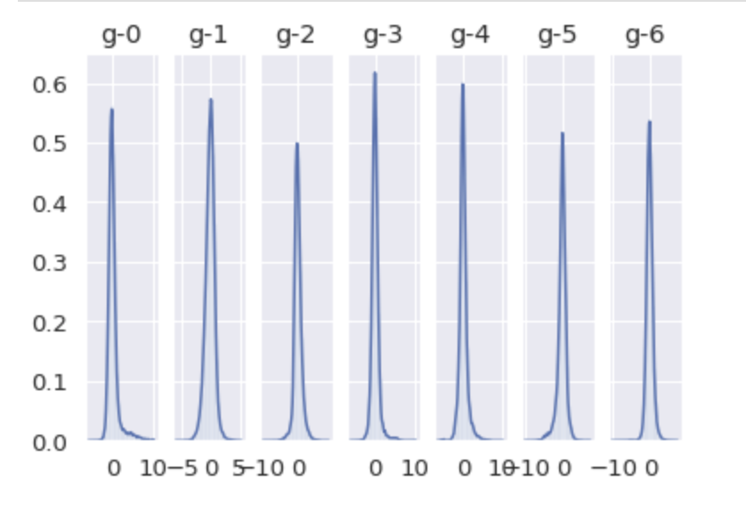
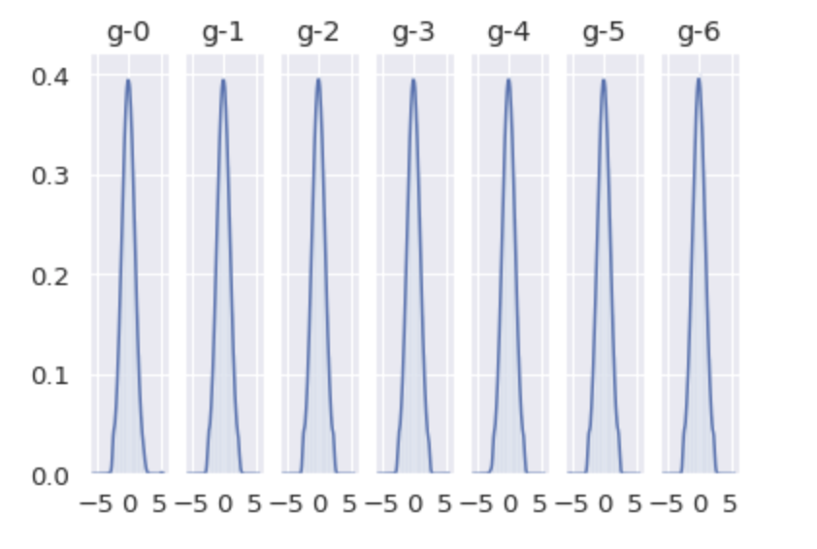
RankGauss
Before RankGauss After RankGauss
Notes:
It appears that we were able to transform the distribution of each data to resemble a normal distribution, as intended. So, let’s enter the data into the benchmarking method to see the improvement.

Slide 31
Data analysis -- PCA
PCA is a method to reduce the dimensionality of dataset. It does so by projecting the dataset onto a lower-dimensional space.
It is used as:
Pre-processing method before classification to reduce computational costs of the classifier.
Compression method for ease of data storage and retrieval.
Feature extraction method

Slide 32
Data analysis -- PCA
Why PCA?
Principal Component Analysis (PCA) is used to explain the variance covariance structure of a set of variables through linear combinations. It is often used as a dimensionality-reduction technique.
Does PCA lose information?
Nope. ... It is useful because it often does not lose important information when you use it to reduce dimension of your data. When you lose data it is often the higher frequency data and often that is less important.

Slide 33
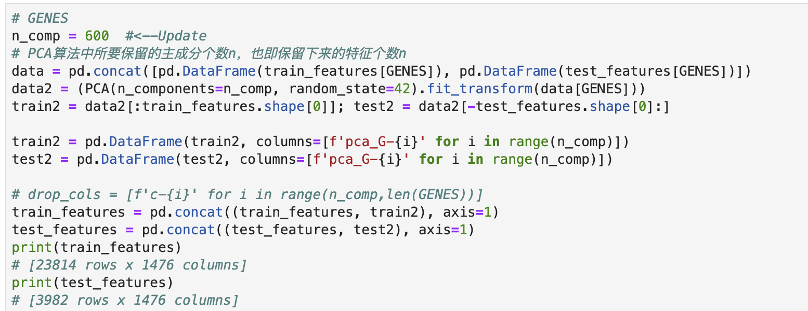
Data analysis -- PCA
N_comp: number of components to keep. If n_components is not set, all components are kept.
Random_state: pass an int value for reproducible results across multiple function calls.
Fit_transform/fit: for fit_transform (X[,y]), it fit the model with X and apply the dimensionality reduction on X; For fit, it fits the model with X.

Slide 34
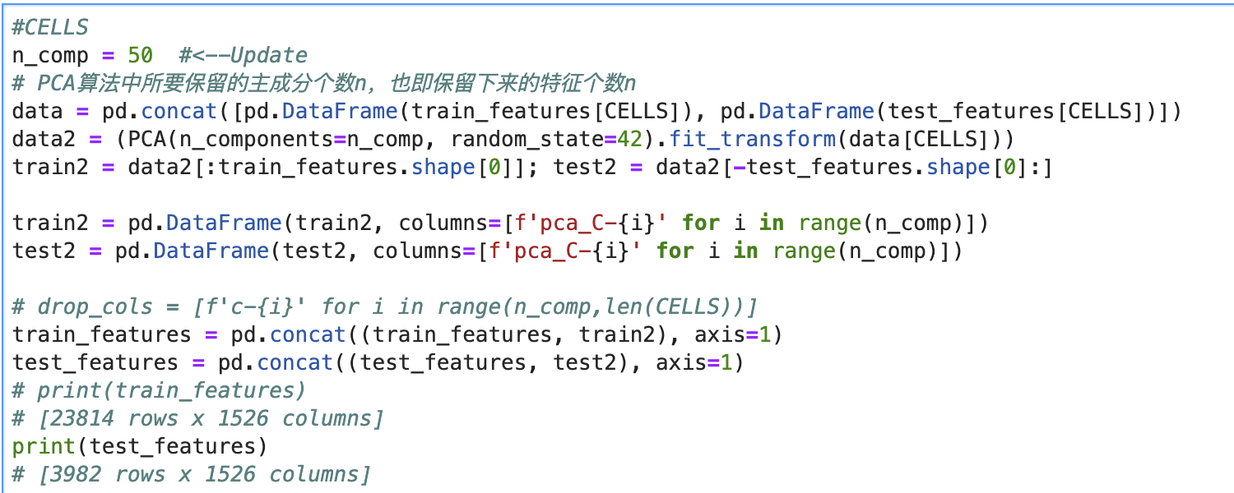
Data analysis -- PCA
In this part, regarding to CELLS, I lower the features of this to 50.
And add these features to the original one to represent.

Slide 35
Variance threshold
Variance threshold from sklearn is a simple baseline approach to feature selection. It removes all features which variance doesn't meet some threshold. By default, it removes all zero-variance features, i.e., features that have the same value in all samples.
Motivated by the idea that low variance features contain less information
Calculate variance of each feature, then drop features with variance below the threshold
Make sure that features have the same scale

Slide 36
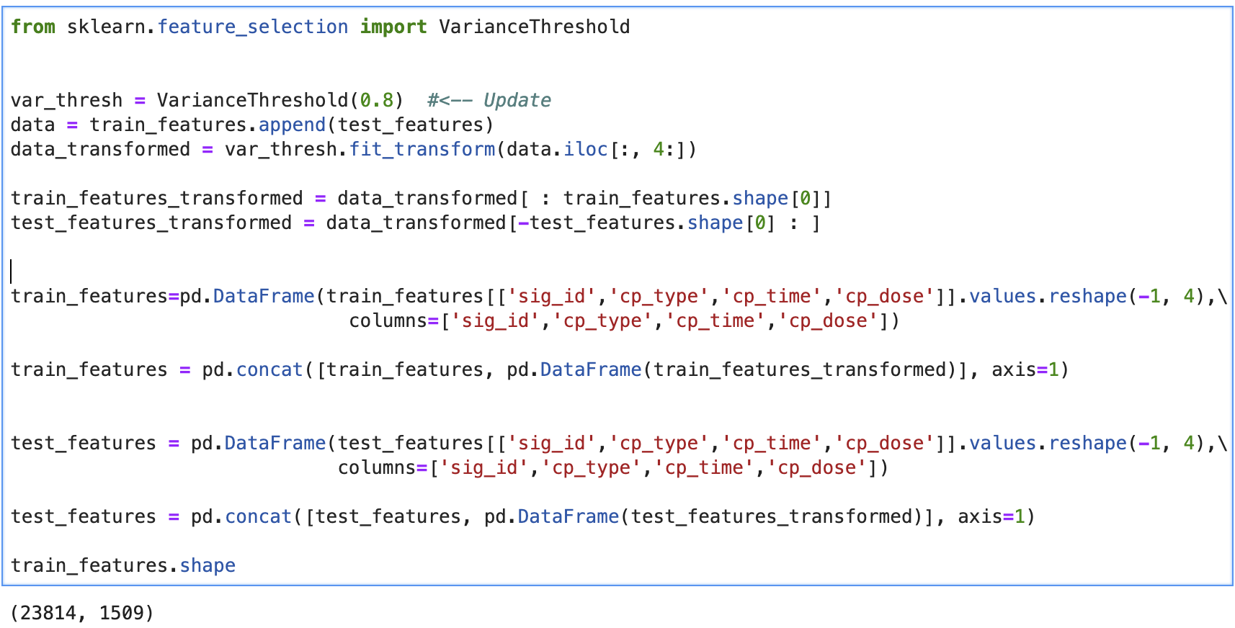
Variance threshold

Slide 37

Thank you!

